Slide 1
CSE102 – Programming Fundamentals
Pointers (Part 1)

Slide 2
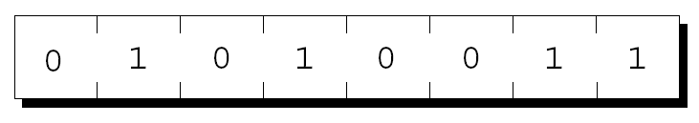
Pointer Variables
The first step in understanding pointers is visualizing what they represent at the machine level.
In most modern computers, main memory is divided into bytes, with each byte capable of storing eight bits of information:
Each byte has a unique address.

Slide 3
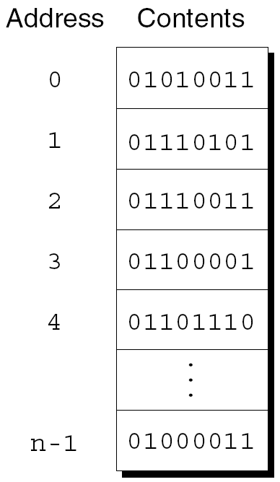
Pointer Variables
If there are n bytes in memory, we can think of addresses as numbers that range from 0 to n – 1:

Slide 4
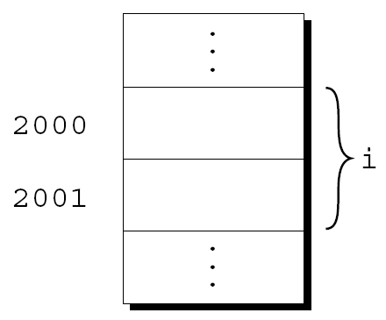
Pointer Variables
Each variable in a program occupies one or more bytes of memory.
The address of the first byte is said to be the address of the variable.
In the following figure, the address of the variable i is 2000:

Slide 5
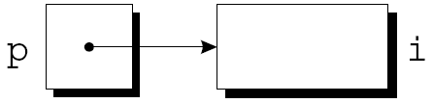
Pointer Variables
Addresses can be stored in special pointer variables.
When we store the address of a variable i in the pointer variable p, we say that p “points to” i.
A graphical representation:

Slide 6
Declaring Pointer Variables
When a pointer variable is declared, its name must be preceded by an asterisk:
int *p;
p is a pointer variable capable of pointing to objects of type int.

Slide 7
Declaring Pointer Variables
Pointer variables can appear in declarations along with other variables:
int i, j, a[10], b[20], *p, *q;
C requires that every pointer variable point only to objects of a particular type (the referenced type):
int *p; /* points only to integers */
double *q; /* points only to doubles */
char *r; /* points only to characters */
There are no restrictions on what the referenced type may be.

Slide 8
Pointer Variable Declaration and Initialization
Pointer declaration
  Multiple pointers require using a * before each variable definition
      int *myPtr1, *myPtr2;
  Can define pointers to any data type
  It’s crucial to initialize p before we use it.
  Initialize pointers to 0, NULL, or an address
    0 or NULL – points to nothing (NULL preferred)

Slide 9
The Address and Indirection Operators
C provides a pair of operators designed specifically for use with pointers.
  &
    To find the address of a variable, we use the & (address) operator.
  *
    To gain access to the object that a pointer points to, we use the * (indirection) operator.

Slide 10
Pointer Operators
& (address operator)
  Returns address of operand
    int y = 5;
    int *yPtr;
    yPtr = &y; /* yPtr gets address of y */
    yPtr “points to” y
y
yptr
y
yPtr
5
500000
600000
600000
5
Address of y is value of yptr

Slide 11
The Address Operator
It’s also possible to initialize a pointer variable at the time it’s declared:
int i;
int *p = &i;

Slide 12
The Indirection Operator
Once a pointer variable points to an object, we can use the * (indirection) operator to access what’s stored in the object.
If p points to i, we can print the value of i as follows:
printf("%d\n", *p);

Slide 13
The Indirection Operator
As long as p points to i, *p is an alias for i.
  *p has the same value as i.
  Changing the value of *p changes the value of i.
The example on the next slide illustrates the equivalence of *p and i.
Notes:
A name that has been assumed temporarily

Slide 14
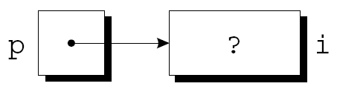
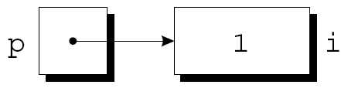
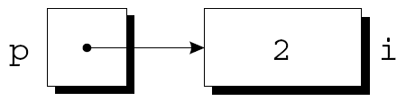
The Indirection Operator
p = &i;
i = 1;
printf("%d\n", i); /* prints 1 */
printf("%d\n", *p); /* prints 1 */
*p = 2;
printf("%d\n", i); /* prints 2 */
printf("%d\n", *p); /* prints 2 */

Slide 15
The Indirection Operator
Applying the indirection operator to an uninitialized pointer variable causes undefined behavior:
int *p;
printf("%d", *p); /*** WRONG ***/
Assigning a value to *p is particularly dangerous:
int *p;
*p = 1; /*** WRONG ***/

Slide 16
Pointer Assignment
C allows the use of the assignment operator to copy pointers of the same type.
Assume that the following declaration is in effect:
int i, j, *p, *q;
Example of pointer assignment:
p = &i;

Slide 17
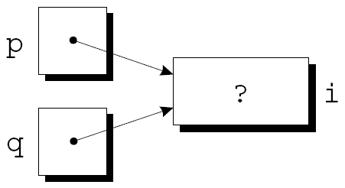
Pointer Assignment
Another example of pointer assignment:
q = p;
q now points to the same place as p:

Slide 18

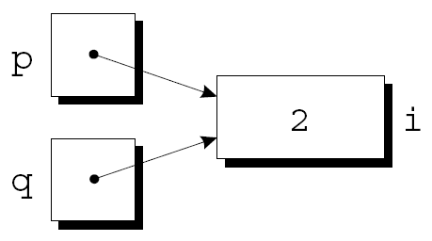
Pointer Assignment
If p and q both point to i, we can change i by assigning a new value to either *p or *q:
*p = 1;
*q = 2;
Any number of pointer variables may point to the same object.

Slide 19
Pointer Assignment
Be careful not to confuse
q = p;
with
*q = *p;
The first statement is a pointer assignment, but the second is not.
The example on the next slide shows the effect of the second statement.

Slide 20
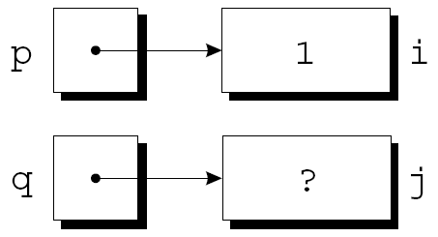
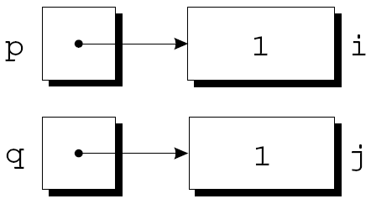
Pointer Assignment
p = &i;
q = &j;
i = 1;
*q = *p;

